Slide 1
Software Development Methodologies – The others
Go through the other methodologies that are not scrum or waterfall (quickly)
Nike
Phased Waterfall
V Model
Spiral
RAD (Rapid Application Development)
DSDM (No idea)
RUP (Rational Unified Design)
Kanban

Slide 2
Software Development Methodologies – Nike*
The “Just do it” approach.
Sit down, scribble a design on a scrap paper, start coding+testing
Pros
Can be very efficient in some circumstances e.g. simple well understood problem
Cons
Only works for very small team (e.g. 1 maybe 2 people)
The team members still need to cover all the main roles (customer, SME, BA, dev and test)
Does not work with complex problems
Does not scale
Quality not ensured
*I just made this methodology up. Do not quote it in an exam!

Slide 3
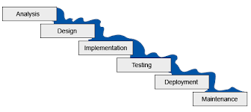



Software Development Methodologies – Phased Waterfall*
In real life the PM normally says to customer “we can not deliver all functionality that in that time”. So she then proposes delivering bits of it in phases over a longer period.
Each phase may be a 3-6 months. It’s almost iterative, but not Agile!
Deliver and get feedback
Deliver and get feedback
Deliver and get feedback
Phase 1
Phase 2
Phase 3
*This is a real methodology that is used in the real world, but may not be well documented, or in your exam.

Slide 4
Software Development Methodologies – Phased Waterfall
Pros
Allows testing and customer feedback at the end of each stage
All the other pros of waterfall
Cons
Still significant upfront analysis and design required
The team can end up supporting, fixing defects, and maintaining the previous phase instead of developing the next
The feedback and defects are rarely included in the PMs plan. Runs over schedule.

Slide 5
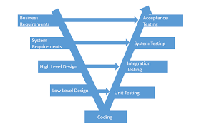
Software Development Methodologies – V model
A weakness of waterfall is that the last stage in any sequential process tends to get squeezed when time is short (always), i.e. testing.
V model based on Waterfall but with focus on testing (don’t leave thinking about it until last)
Write the relevant test spec at each stage
The start of the TDD tests first approach?
Not Agile and not iterative
Pros
Focus on testing improves quality
Cons
Test still not run until coding complete
No feedback from failed tests or customer until late in the process
Aka – Validation Model or Verification Model

Slide 6

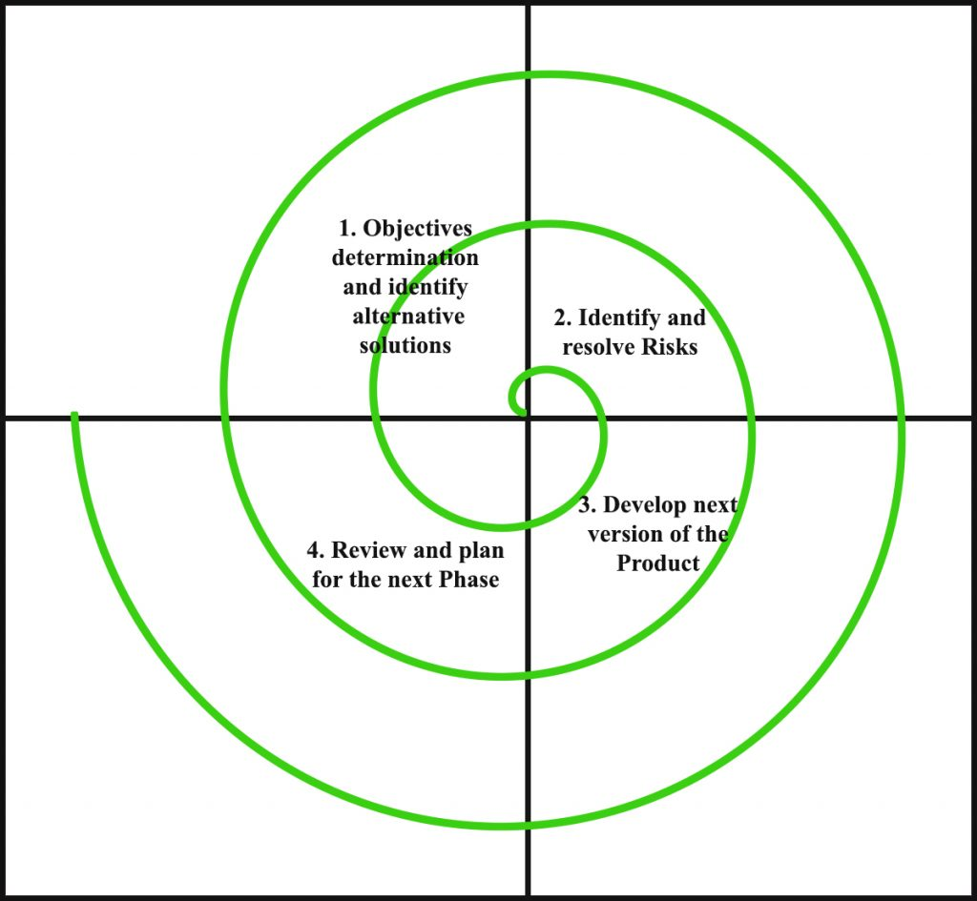
Software Development Methodologies - Spiral
Use the risk pattern of a project to decide what model to actually use (could use waterfall during the build quadrant)
Each loop produces a product with increasing scope/completeness?
Use for risky, complex, ill defined projects?
Potentially both sequential and incremental?
Is iterative but not Agile?
Design
Identification
Pros
User sees product and can give feedback after each cycle
Risky parts done early?
Cons
Complex management
Complex process
Lots of docs
Evaluate/analysis risk
Build

Slide 7

Software Development Methodologies - RAD
Rapid Application Development (RAD). Is really a group of adaptive/agile methods (Spiral is RAD!)
Often driven by UI requirements (RAD tools)
Early prototyping?
Pros
Fast user feed back
Better quality?
Risk control
Cons*
Needs commitment from key resources (customers/experts/etc)
Less (management?) control
Poor design? Hack and test?
Poor scalability
*All classic adaptive/agile problems, skater dudes

Slide 8

Software Development Methodologies - DSDM
Dynamic system development method (DSDM)
RAD with more discipline?
MoSCoW requirement prioritization (musts, should, coulds, wonts)
Pros
Focus on business needs
Focus on quality
Cons
Strict and hard to follow rules?

Slide 9

Software Development Methodologies – XP (eXtreme Programming*)
Agile
Frequent releases
Pair programming
Code reviews
Unit tests!
Flat management
Expect change
Code simplicity
YAGNI (you aint gonna need it)
Pros
What’s not to like?
Cons
Lack of structure and discipline?
*Takes things to extremes. E.g. If code reviews are good, then do it all the time ➔ pair programming

Slide 10
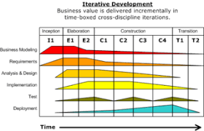
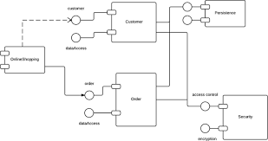
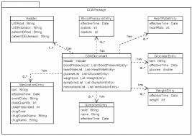
Software Development Methodologies - RUP
Rational Unified Process (RUP)
Created by IBM (Rational Software Corp).
Based on UP!
Iterative framework
Uses UML (Unified Modeling Language)
Pros
Agile but with structure?
Cons
Complicated
Steep learning curve?

Slide 11
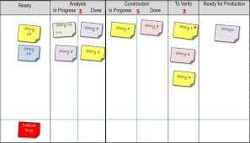
Software Development Methodologies - Kanban
Means “signboard” in Japanese?
Based on Lean manufacturing system in Toyota? Focus on eliminating waste.
Agile with “work in progress” limits
Aim to get high through put (easy to spot points at which bottlenecks occur)
Can be combined with scrum in “Scrumban” mash up
Pros
Its great
Cons
None*
*See disclaimer at start

Slide 12

Software Development Methodologies - Questions
Q1 – What about TDD and DevOps? Are they methodologies or just part of good Agile practice?
Q2 – What about SAFe and LeSS?

Slide 13
Software Development Methodologies

